Slide 1
Boosting gender equality in research:
the importance of targeted decisions for Europe
Anna Rita Manca
European Institute for Gender Equality

Slide 2
Gender Equality is a fundamental value
in EU and is vital to its
economic and social growth
Notes:
Equality between women and men is a fundamental value of the European Union, enshrined in its Treaties
Treaty of Rome (1957):
[…]men and women should receive equal pay for equal work( and work for equal value).
Amsterdam Treaty (1997):
The Community shall aim to eliminate inequalities, and to promote equality, between men and women.
[…] equality between men and women with regard to labour market opportunities and treatment at work
[…] adopt measures to ensure the application of the principle of equal opportunities and equal treatment of men and women in matters of employment and occupation, including the principle of equal pay for equal work or work of equal value.
Lisbon Treaty (2007/C306/01) emphasised
the importance of eliminating all types of discrimination,
including those based on sex, through the Charter of
Fundamental Rights of the European Union (2000/C364/01),
and gave renewed attention to how gender-based violence
of the European Union (2000/C 364/01) threatened
the integrity and dignity of women and men in the EU.

Slide 3
Treaty of Rome
1957
Amsterdam Treaty
1997
Charter of Fundamental Rights
2000
Strategy on Gender Equality
2001-2005
Roadmap for Equality between Women and Men 2006-2010
Lisbon Treaty
2007
Women’s Charter
2010
Strategy for Equality between Women and Men 2010–2015
EU’s 10-year growth strategy
Europe 2020
Notes:
Treaty of Rome (1957):
[…]men and women should receive equal pay for equal work( and work for equal value).
Amsterdam Treaty (1997):
The Community shall aim to eliminate inequalities, and to promote equality, between men and women.
[…] equality between men and women with regard to labour market opportunities and treatment at work
[…] adopt measures to ensure the application of the principle of equal opportunities and equal treatment of men and women in matters of employment and occupation, including the principle of equal pay for equal work or work of equal value.
Lisbon Treaty (2007/C306/01) emphasised
the importance of eliminating all types of discrimination,
including those based on sex, through the Charter of
Fundamental Rights of the European Union (2000/C364/01),
and gave renewed attention to how gender-based violence
of the European Union (2000/C 364/01) threatened
the integrity and dignity of women and men in the EU.
The Europe 2020 strategy is about delivering growth that is: smart, through more effective investments in education, research and innovation; sustainable, thanks to a decisive move towards a low-carbon economy; and inclusive, with a strong emphasis on job creation and poverty reduction. The strategy is focused on five ambitious goals in the areas of employment, innovation, education, poverty reduction and climate/energy.
How will the EU boost smart growth?
Through 3 flagship initiatives:
1. Digital agenda for Europe Creating a single digital market based on fast/ultrafast internet and interoperable applications:
by 2013: broadband access for all
by 2020: access for all to much higher internet speeds (30 Mbps or above)
by 2020: 50% or more of European households with internet connections above 100 Mbps.
2. Innovation Union
refocusing R&D and innovation policy on major challenges for our society like climate change, energy and resource efficiency, health and demographic change
strengthening every link in the innovation chain, from 'blue sky' research to commercialisation
3. Youth on the move
helping students and trainees study abroad
equipping young people better for the job market
enhancing the performance/international attractiveness of Europe's universities
improving all levels of education and training (academic excellence, equal opportunities)

Slide 4
How do we monitor the progress of Gender Equality in Europe?

Slide 5
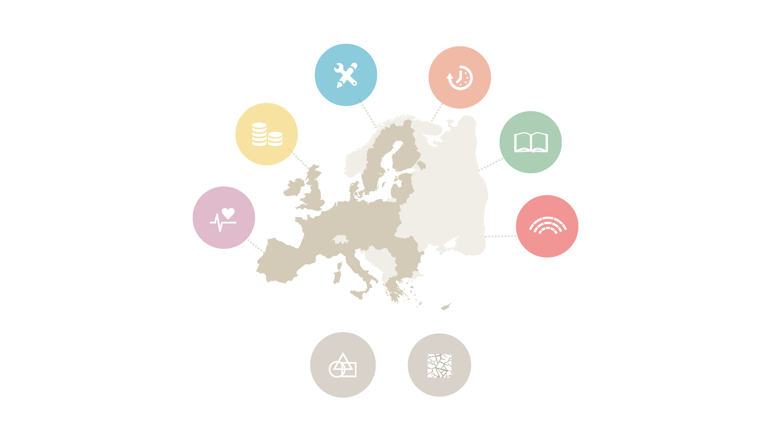
Notes:
Devising a Conceptual Framework
This is the structure of the conceptual framework of the Gender Equality Index. It consists of eight domains, which are themselves sub-divided into sub-domains.
I will now go into more details into each one of these domains.

Slide 6
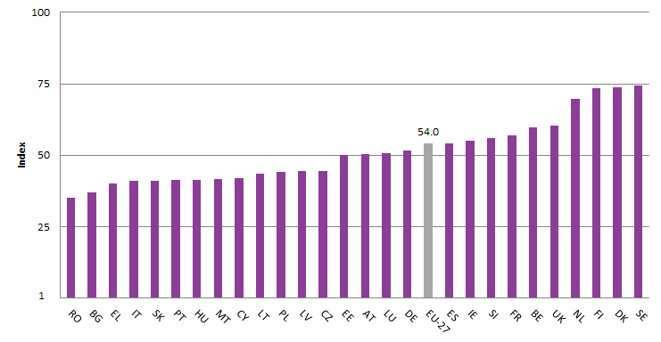
Room for improvement
54.0
Notes:
After 50 years of gender equality policies with an average score of 54.0, the EU remains far from reaching its gender equality aim although its overall score shows that it is half way there.
The range across Member States from 35.3 to 74.3 shows the large amount of variation throughout the EU in the level of Gender Equality achieved overall.
SE, DK, FI and NL despite the fact they are clearly leading the ranking of the MSs, have reached as core between 60 and 74, which is below three quarter toward equality. This is not enough at all!

Slide 7
Gender Equality is not yet a reality in the European Union …

Slide 8
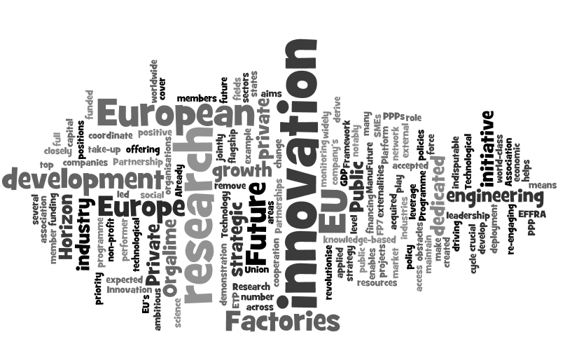
Notes:
The target of EUROPE 2020 for smart growth has a clear and important focus on innovation and research, but how to make the link with Gender equality since it is a fundamental value in EU?

Slide 9
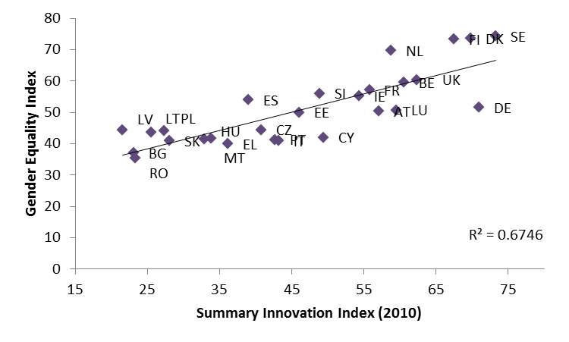
Innovation vs Gender Equality

Slide 10
Investment in R&D as % of GDP
(2002-2012)
Notes:
EU targets for smart growth include:
combined public and private investment levels to reach 3% of EU's GDP as well as better conditions for R&D and Innovation
2. 75% employment rate for women and men aged 20-64 by 2020– achieved by getting more people into work, especially women, the young, older and low-skilled people and legal migrants
3. better educational attainment – in particular: – reducing school drop-out rates below 10% – at least 40% of 30-34–year-olds with third level education (or equivalent)

Slide 11
Gender equality Index vs Investment in R&D

Slide 12
Women and men in research …

Slide 13
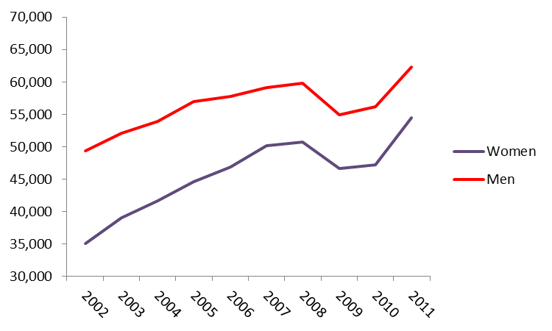
Distribution of PHD graduates
(2002-2011)

Slide 14
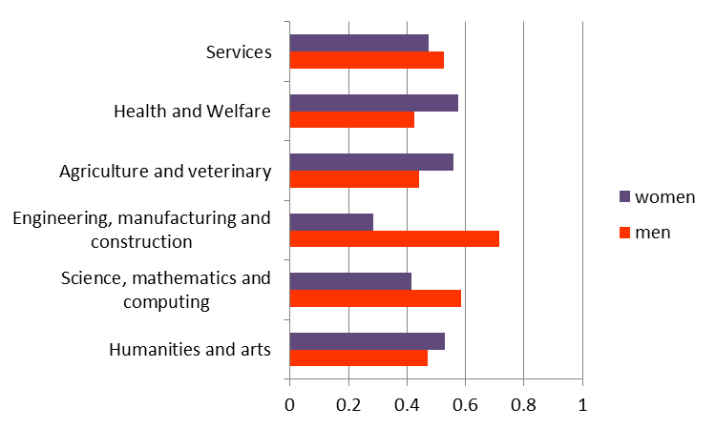
Distribution of PHD graduates by field of study (2011)
Notes:
Key initiative of Innovation Union
Promoting excellence in education and skills development
By the end of 2011, Member States should have strategies in place to train enough researchers to meet their national R&D targets and to promote attractive employment conditions in public research institutions. Gender and dual career considerations should be fully taken into account in these strategies.
Delivering the European Research Area
By 2015, Member States together with the Commission should have completed or launched the construction of 60% of the priority European research infrastructures currently identified by the European Strategy Forum for Research Infrastructures (ESFRI). The potential for innovation of these (and ICT and other) infrastructures should be increased. The Member States are invited to review their Operational Programmes to facilitate the use of cohesion policy money for this purpose.
Focusing EU funding instruments on Innovation Union priorities
Future EU research and innovation programmes will focus on Europe 2020 objectives and particularly the Innovation Union.

Slide 15
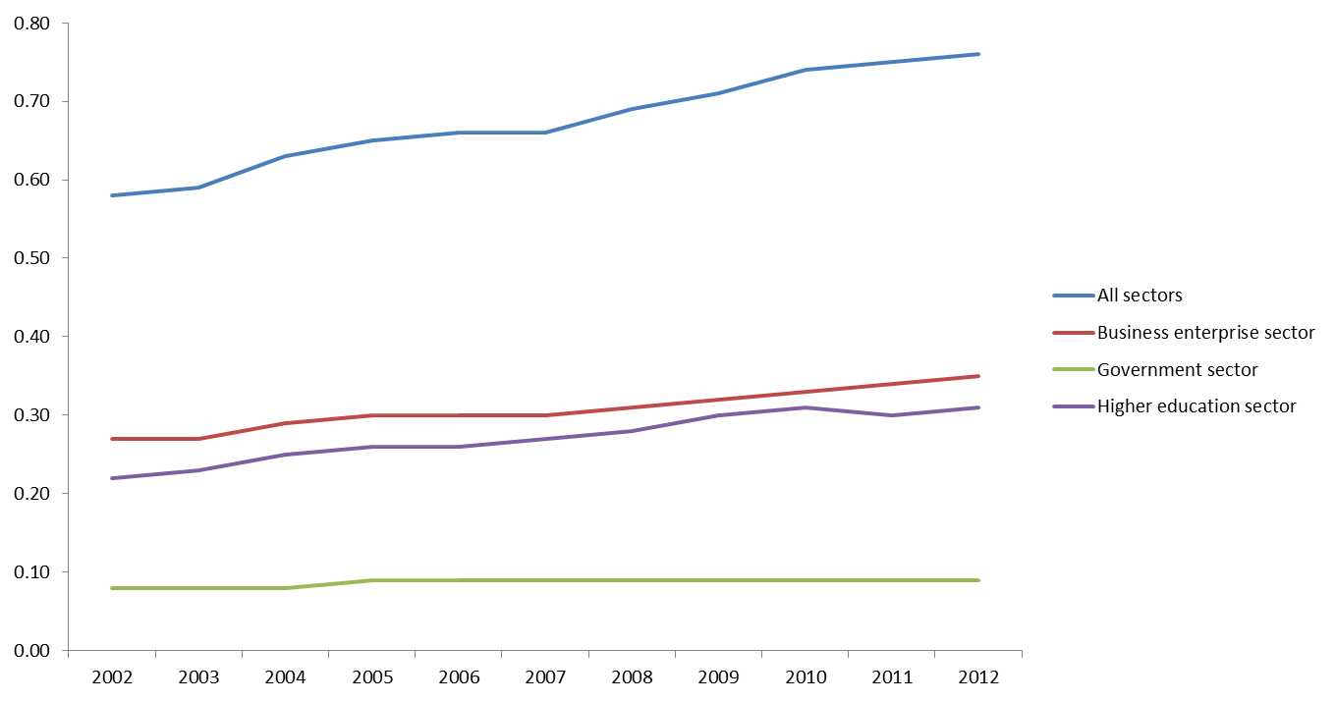
Total researchers by sector as % of total employment (FTE)

Slide 16
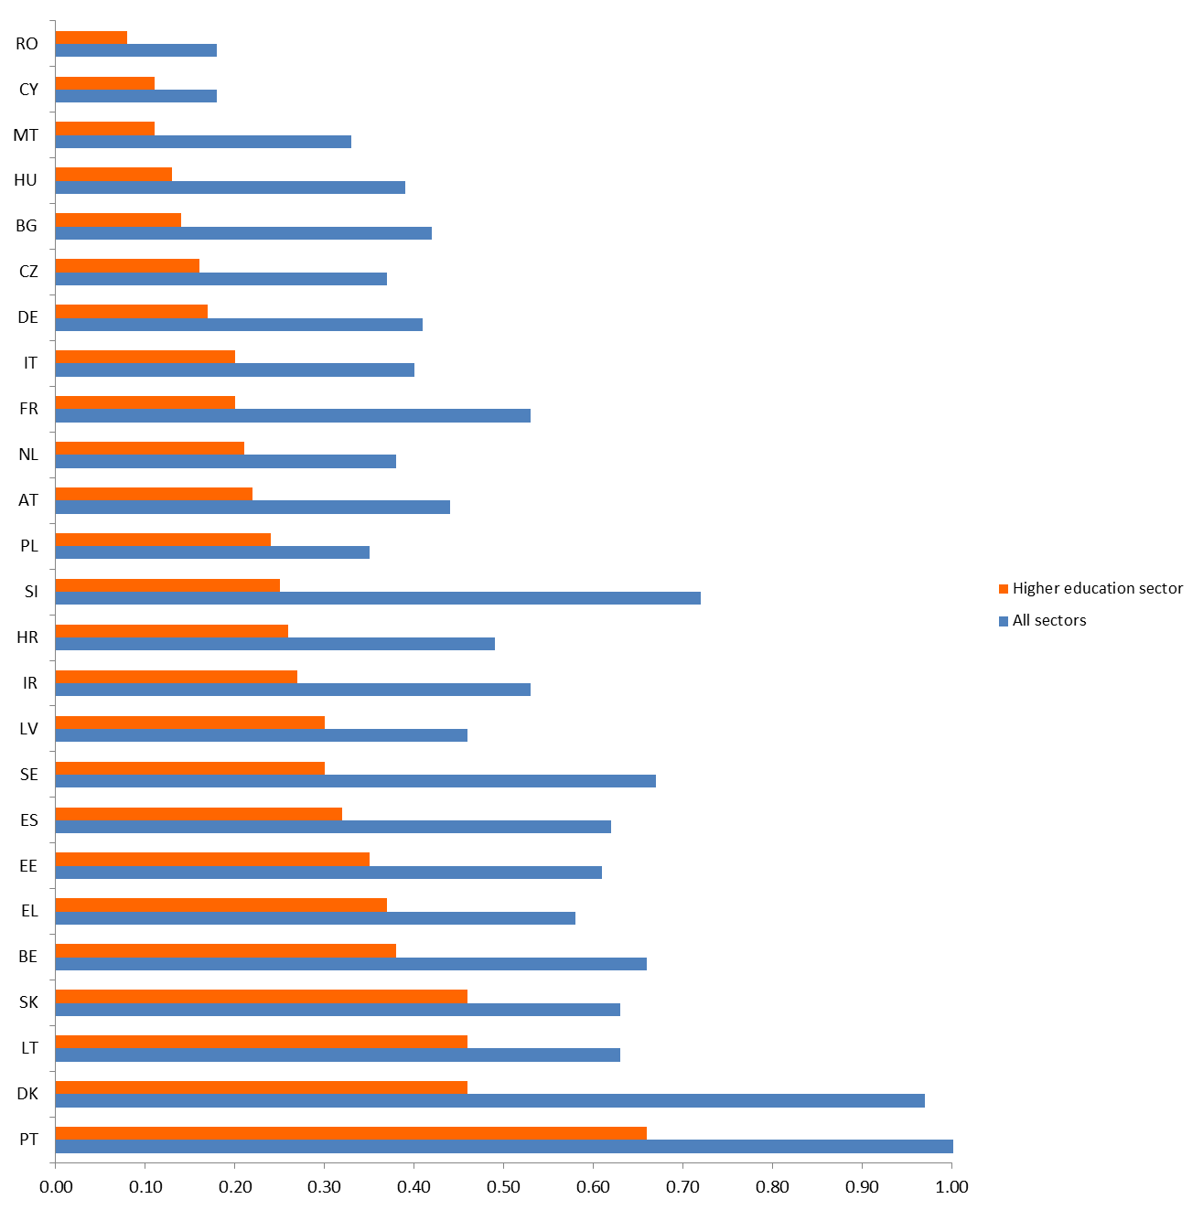
Women researchers by sectors as % of total employment (FTE) in 2011

Slide 17
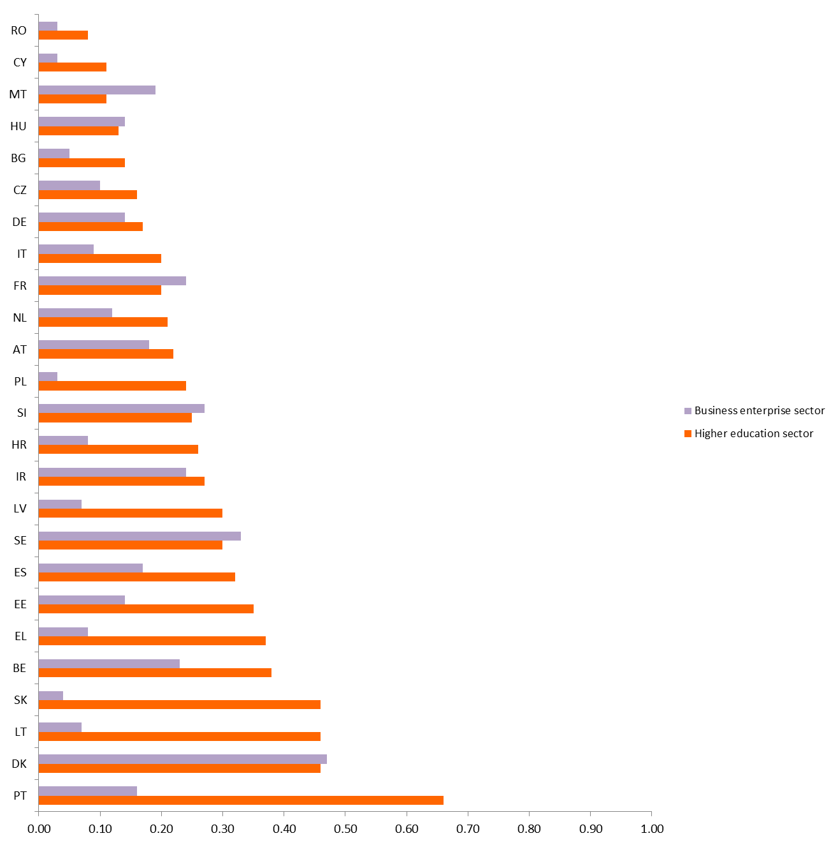
Women researchers by sectors as % of total employment (FTE) in 2011

Slide 18
Women and men in the institutions…

Slide 19
Low levels of gender equality in political decision-making
The lowest gender equality score can be found in economic decision-making
Key actions should be taken to consider gender balance in decision-making
Notes:
Women are greatly underrepresented in top positions of decision making in the majority of the Members States.
Despite the fact that women make up nearly half of the workforce and account for more than half of tertiary of level graduates, the proportion of women involved in top-level decision-making remains very low. This discrepancy shows a waste of highly-qualified and skilled human resources.
Low levels of representation in political decision-making
Women compared with men are grossly under represented in some parts of political and economic decision making.
Despite the fact that women make up nearly half of the workforce and account for more than half of tertiary of level graduates, the proportion of women involved in top-level decision-making remains very low.
A waste of highly qualified and skilled human resources.
The lowest gender equality score can be found in economic decision-making
The greater deficit representation can be observed in economic power, namely the participation of women on boards of the largest quoted companies. This provides support to the launch by the European Commission in 2011 of the “Women on the board Pledge for Europe”. A call for companies to sign a voluntary commitment to increase women’s presence on corporate boards (30%-2015; 40%-2020)
Key actions should be taken to consider gender balance in decision-making
This finding proves the importance of the key actions taken by the EC:
- Strategy for Equality between Women and Men 2010-2015 to consider gender balance in decision-making; monitor progress towards the aim of 40% of members of one sex in committees and expert groups established by the Commission and support efforts to promote greater participation by women in European Parliament elections including as candidates.

Slide 20
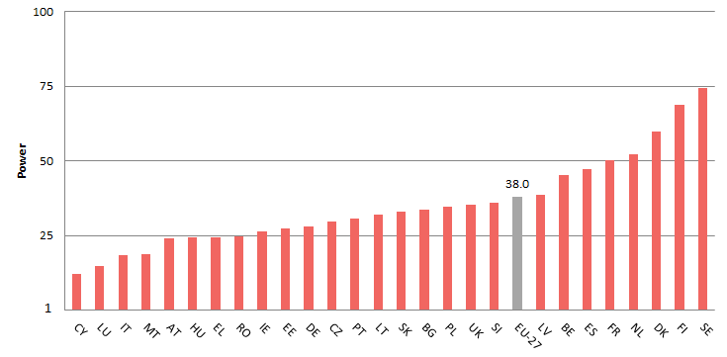
38.0
Notes:
This is the area where the lowest gender equality score can be observed: the EU average is 38.0! LT – 32.1
The majority of Member States is below this level. 30 % of the countries are three quarter far away from full gender equality, within them MT, IT, LU and CY have a score below 20! Only four countries, NL, DK,FI and SE present a score between 50 and 75 % toward equality, but this is not a result we should be proud.
Power is probably the only domain where gender equality can be reached faster than in other domains if we apply consistently ad hoc policy, such as the introduction of quotas.

Slide 21
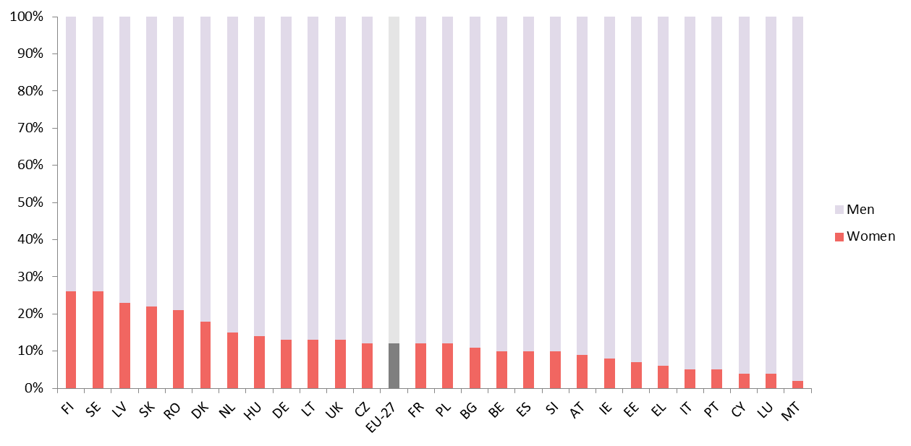
Women and men as members of the boards of the largest quoted companies

Slide 22
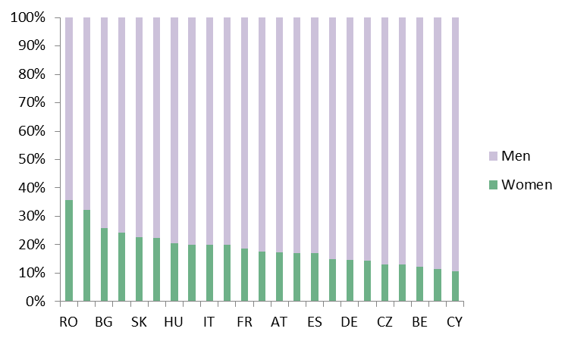
Women and men as academic staff
(highest grade) 2010

Slide 23
Outcomes
Women make up half of the work force,
…but only 40% are employed (FTE) ;
Only 5% of women are researchers
… but in 2010, around 60% of university graduates were women ;
Women are underrepresented in decision making power
…as well as in the highest academic positions;

Slide 24
Barriers
Stereotypes in gender roles toward :
Career opportunities for women in decision making;
Gendered organisation of work ;
(work/life balance, concentration of power)

Slide 25
Prerequisites for undertaking structural change
Knowing the institution: developing statistics to monitor (administrative data);
Securing top level support from persons in positions of responsibility;
Implementing Gender Mainstreaming
Notes:
Knowing the institution, by developing statistics and indicators, so that the situation of each institution becomes widely known and acknowledged
getting top level support from persons in positions of responsibility
generating effective management practices, by ensuring gender expertise and by raising awareness.
What it GM about?
It is the way to address different needs of women and men
Eg:
if we want to assess excellence in research we need to take into account different criteria in addition of the # publication is not objective and not suitable for instance for women who take care of family, who may have career breaks.

Slide 26
Institutional mechanism for gender mainstreaming
Institutional capacity and use of methods and tools (Gender Impact Assessment)
Competence development – support in implementation
Notes:
Review of the Institutional Capacity and Effective Methods, Tools and Good Practices for Mainstreaming Gender Equality. (prepared for EIGE by the Yellow Window management consultants).
Overall objective of the study: Gather information and evidence for strengthening the mainstreaming of gender equality into selected European Union policies and subsequent national policies.
Specific objectives of the study: 1. To increase the knowledge on institutional capacity and effectiveness of gender mainstreaming by the European Commission and the EU Member States.
2. To promote the use of Gender Impact Assessment (GIA) as a tool for mainstreaming gender equality in the European Commission and the EU Member States.

Slide 27
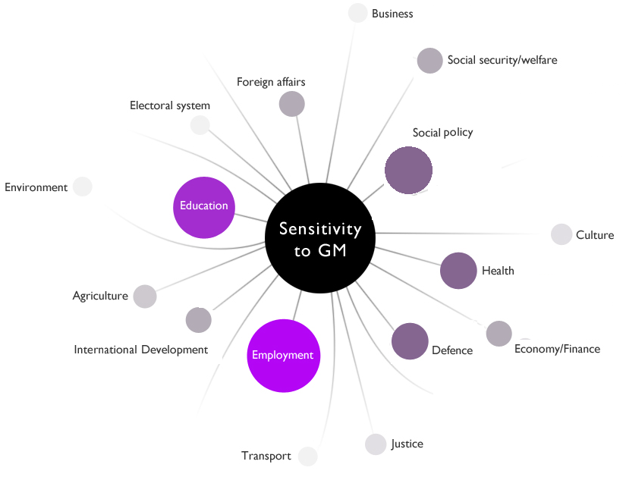
Institutional capacity
Notes:
Gender mainstreaming implementation in the EU Member States
Policy areas most sensitive to gender mainstreaming
The review of gender mainstreaming in the selected policy areas fits broadly within the assessment of general institutional capacity for each country.
Still, there is no automatic correlation between the overall institutional capacity for gender mainstreaming within a country and the ways in which this is implemented in the selected policy areas.
However, countries categorised as “Project” level tend to produce gender blind sectoral policies. Countries in this cluster tend not to demonstrate evidence of impact drivers for gender mainstreaming, and the most frequent are resources and stakeholder involvement.
Depicting countries in the “isolation” phase, there is a more even mixture of gender blind policies and those which partially integrate or consider gender.
The majority of countries in the “growth” phase have some structures or arrangements for gender mainstreaming in one or both policy areas, and most countries have partially integrated gender or are gender sensitive in these two areas. A wider range of impact drivers are also identified than for countries in the earlier two phases, including organisational culture and leadership.
The assessment of policy areas in the two “integration” level countries is less consistent with the overall assessment of institutional capacity, and only a narrow range of impact drivers were identified.
Souce of resources : ESF and Progress

Slide 28
Institutional capacity in Research and Innovation
Overall assessment of gender mainstreaming in research and innovation
Gender blind | Gender partially integrated | Gender sensitive
Impact drivers Strategic policies on R&I Specific structures for GM in R&I Use of sex disaggregated data Recognition of gender differences (e.g. in roles and responsibilities) Gendered structure or system (reproduction of inequalities)
Notes:
Stakeholder involvement – participation of NGOs and experts structurally embedded in the process
Coverage of policy cycle – ex-ante (GIA), throughout implementation, ex-post (evaluation)
Availability of resources – funds and staff dedicated to GE/GM, capacity development part of the process
Access to gender expertise – internal and external; use of expertise is systematically planned
Transparency and accountability –incentives (job assessments) and sanctions (career prospects) are in place. Obligatory reporting on results.
Structured understanding of gender (in)equalities – sex desegregated statistics, context related specific objectives in place
Organisational culture – GE seen as a value for the organization, openness to learning and structural change
Leadership actively committed to GE/GM – Explicit commitment from top level that GE/GM is a priority
Daily routines consider gender – gender sensitive and gender specific routines.

Slide 29
Main findings
Goals underlying GM reveal different types of values
Sex-disaggregated data the most commonly used method for GM
The presence of commitment to Gender Equality does not imply that a GM strategy (or consciously planned approach) is in place.
Notes:
GM has been adopted and is implemented as a strategy towards realising gender equality. However:
The goals underlying gender mainstreaming and gender equality actions in Member States reveal different types of values. What in some countries is regarded as gender equality policy objectives, might be contested elsewhere.
There seems to exist a lack of clarity on whether GM is meant to avoid unequal impacts of policies on women and men, to ensure gender-neutral policies, or rather to redress existing inequalities through policies wherever possible.
Implementation of GM is quite patchy across the countries. The research findings indicate a tendency of applying GM on a “à la carte” basis.
The absence of the mobilisation of other methods besides sex-disaggregated statistics and weak institutionalisation of impact drivers are indicators of resistance to go beyond mere information provision and to address the structural roots of inequalities..
The use of certain GM methods does not necessarily mean that a GM strategy (or consciously planned approach) is in place.
GM seems to be on a sidetrack, not well connected to the mainstream of governmental policies.
Important positive drivers for gender mainstreaming:
the EU thorugh legislation and the EC through its funding programmes
the United Nations, although to a lesser extent
However, these organisations are weakening their pushing efforts, which has noticeable effects in terms of reduced efforts undertaken in the Member States.
This might be one of the reasons that backsliding and a reversal of progress are found in several EU Member States.
Access to gender expertise is still not widely available to a majority of Member States. This situation only partly accounts for the under-development of research and expertise on gender, as the expertise necessary to inform policy making is at hand in most of the MS. This is also confirmed by the EIGE’s project on Gender Training and mapping of gender trainers in the EU. Therefore, in most of the cases, it rather indicates that available gender expertise is consulted only on an ad-hoc basis, and not embedded in the policy process, when it is not simply disregarded. This lack of access to gender expertise also applies to the intra-institutional level. This considerably limits the capacity of policy actors to articulate a structured understanding of gender (in)equalities in a majority of countries, also due to the lack of comprehensive and systematically collected sex-disaggregated data.
Those recommendation are going to be used into the council conclusion

Slide 30
Recommendations:
- Strengthened legal obligations for GM
- Enhanced cooperation and networking
- Development of indicators for monitoring GM
- Commitment to improve gender competence of civil servants across different sectors.
Notes:
Examination of experiences from the countries that made the biggest progress in GM show that what is necessary is:
Strengthening legal obligations for gender mainstreaming, including for the use of tools and methods such as Gender Impact Assessment;
Establishment or strengthening of an inter-ministerial structure and focal points in every ministry and ensuring enhanced networking and cooperation within the structure and with the governmental body on gender equality.
Promotion of consultation of the governmental body for GE by other departments and ministries, and have regard for the consultation results by adjusting policies/legislation or programmes by making this a legal obligation with all new policies and legislation.
Strengthening the legal and institutional commitment to improving gender competence of civil servants across the different sectors.
Ensure that gender training provision goes beyond generic, one-off courses; that it is a continuous task that takes into account the needs of participants.
Establish or strengthen an inter-ministerial structure and ensure enhanced networking and cooperation within the structure and consultation with the governmental body on gender equality;
Introduce legal obligations for the use of GM tools and methods, including gender analysis, gender impact assessments and gender budgeting;
Strengthen the legal and institutional commitment to improving gender competence of civil servants across the different sectors.

