Slide 1
Neck Injury Prevention: Male and Female Occupant Models in Crash Testing
Dr Astrid Linder
Research Director, Traffic Safety
The Swedish National Road and Transport Research Institute
SAPGERIC Conference, Vilnius, 22 November 2013

Slide 2
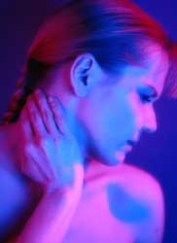
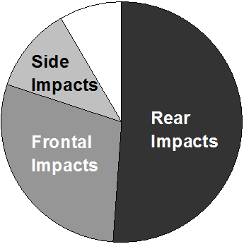
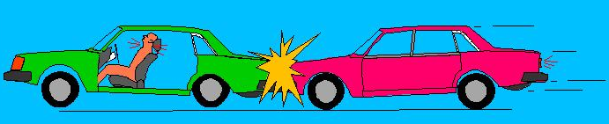
Whiplash Injuries
Most common in rear impacts
Different level of protection in different car model and seat designs
Based on Krafft (1998)

Slide 3
Whiplash injuries
App. 70% of the costs of all injuries leading to permanent medical impairment for the insurance companies
Europe: 800 000 injuries annually, 40 000 result in long term suffering
Costs: > 10 billion € in Europe
Notes:
Lite statistik för Sverige…
- Varje år anmäls 30 000 personer nackbesvär efter bilkollision
Av dessa får
- 1500 en invaliditetsgrad på mer än 10%
- och 500 blir helt arbetsoförmögna
Kostnaden för svenska samhället överstiger 4 miljarder kronor

Slide 4
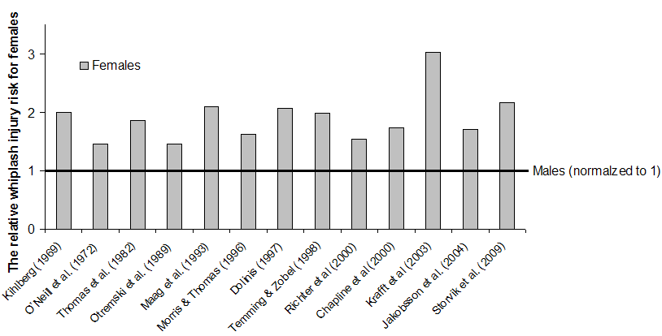
Whiplash – Risk of injuries
Notes:
Kvinnor har upp till 3 gånger högre risk för whiplash-skada jämfört med män.
I den här figuren har jag sammanställt risken för kvinnor jämfört med män för en rad studier under 40 år – från 1969 till 2009.
Männen är här representerade av en horisontell linje = 1.
I den första studien från Kihlberg (1969) är risken alltså dubbelt så stor för kvinnorna jämfört med männen.
I studien från Krafft m fl (2003) ser ni att kvinnorna hade en 3 gånger så hög risk.

Slide 5
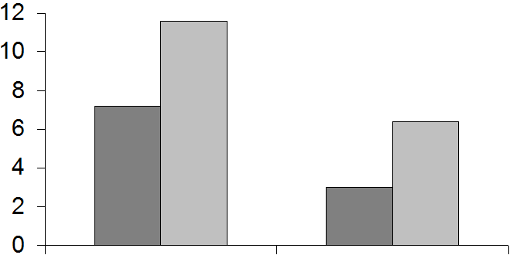
Whiplash protection systems
Injury Statistics – Folksam (Kullgren & Krafft 2010)
Whiplash protection systems less effective for females than for males
Females
Males
45%
Data based on:
- permanent medical
impairments
- all whiplash protection
systems
Risk
57%
Without
Whiplash Protection
With
Whiplash Protection

Slide 6
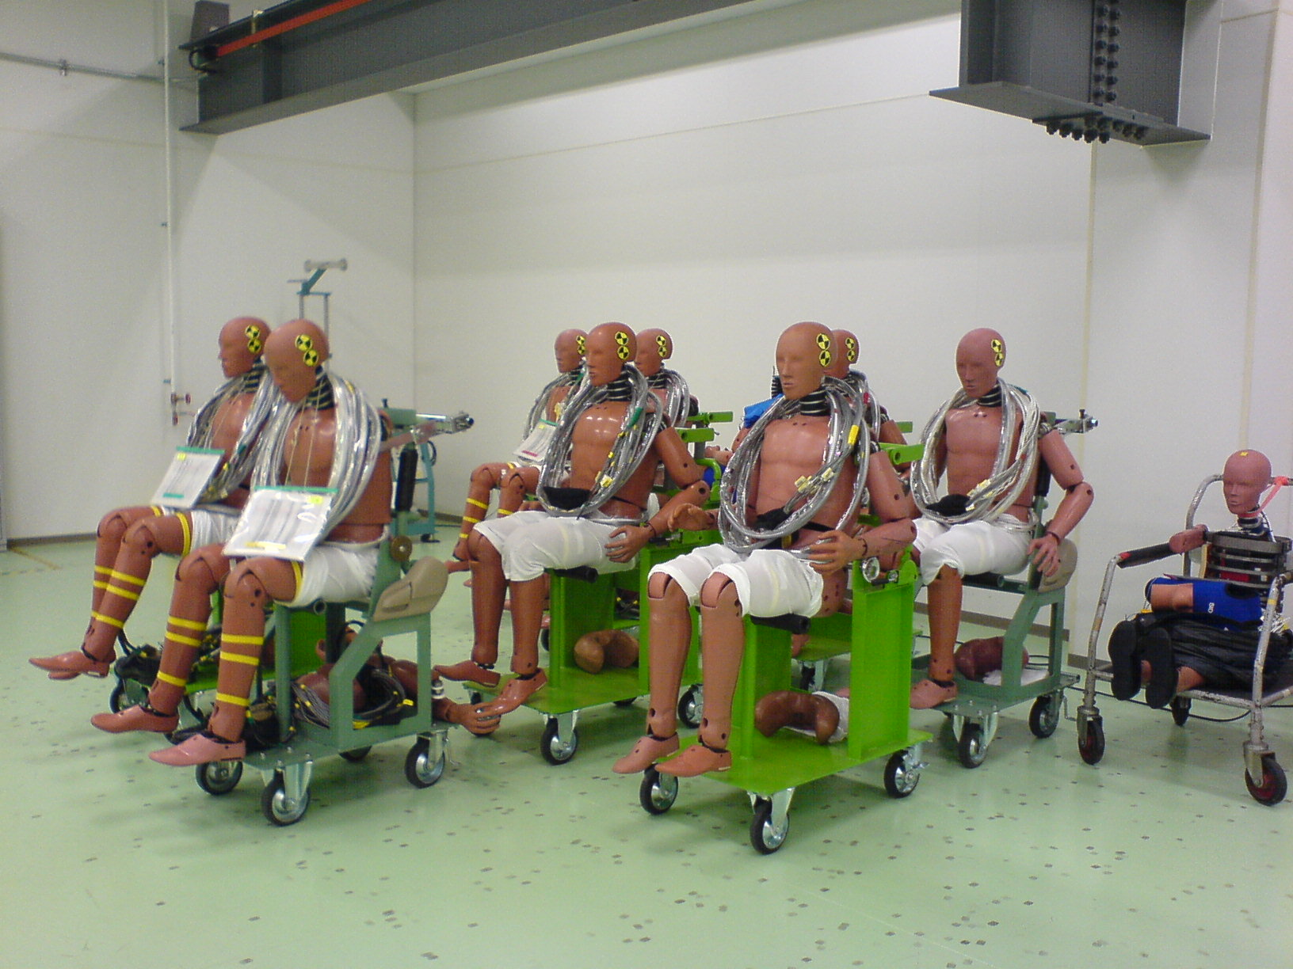

Slide 7
ADSEAT the project
Aims
Reduce the risk of whiplash injuries by enhanced understanding of injury criteria and development of seat evaluation tools.
Develop a finite element dummy model of an average female, named EvaRID (Eva – female/RID – Rear Impact Dummy).
Budget: 3.45 million Euros, 2.5 million Euros
from the European Commission, FP7.
12 partner
Duration: 42 months, 2009-2013

Slide 8

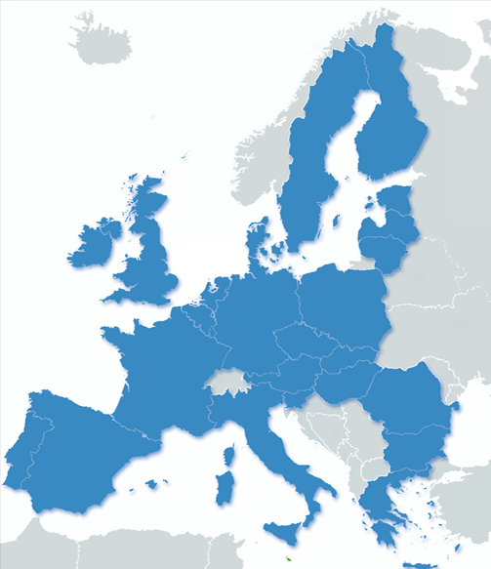












ADSEAT Partners

Slide 9
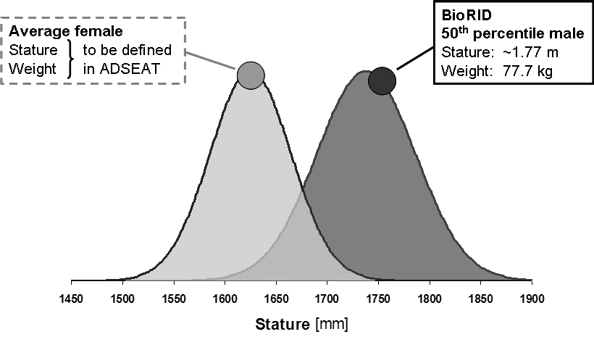
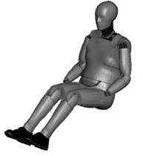
ADSEAT

Slide 10
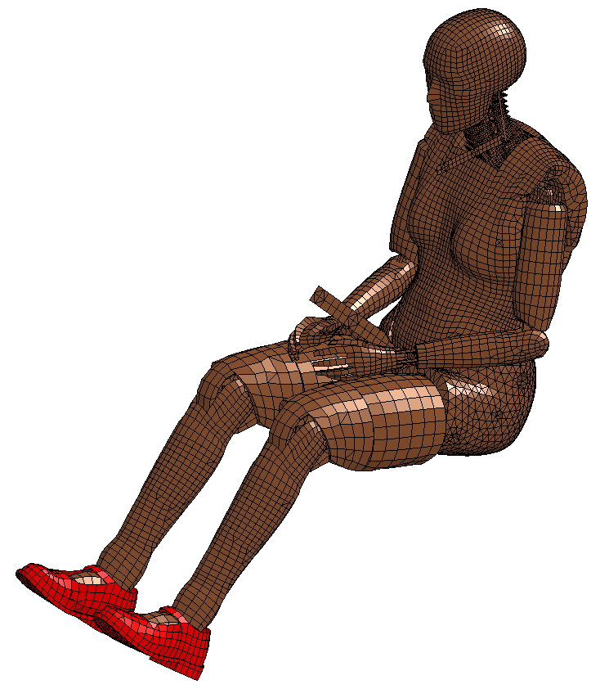
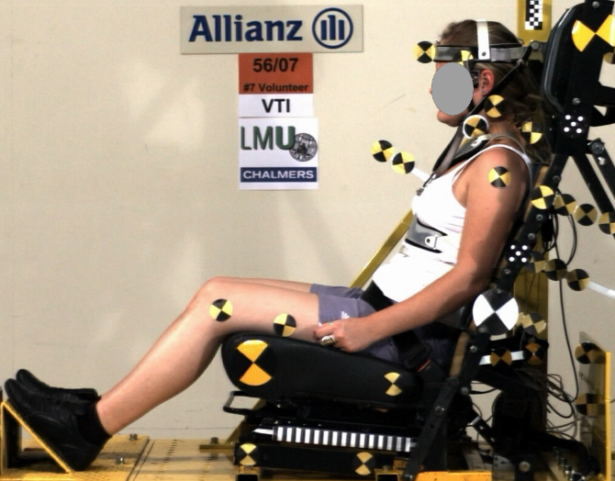
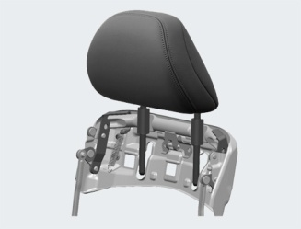
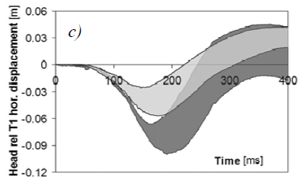
EvaRID
Platform for implementing research findings ADSEAT
Real World Data
Size selection
Assessment Criteria & thresholds
Threshold values
Biological Tests
Anthropometry
Response corridors
Seat design
Use model in evaluation studies

Slide 11
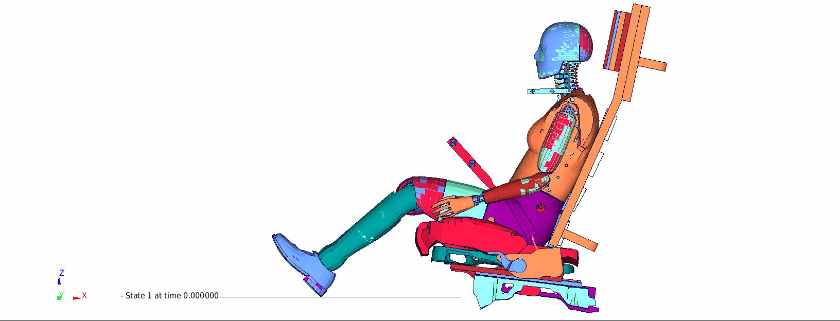
EvaRID simulation volunteer tests

Slide 12
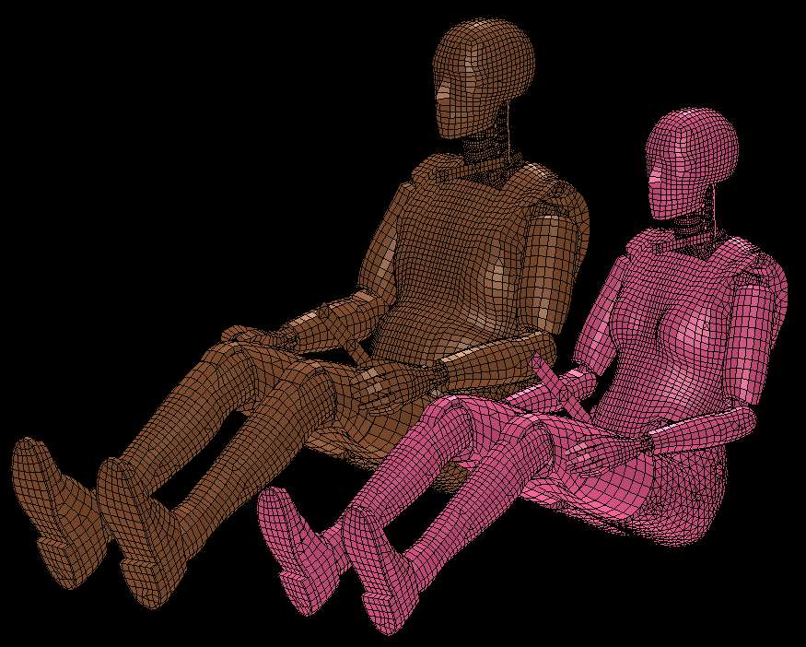
EvaRID – BioRID
BioRID
EvaRID

Slide 13
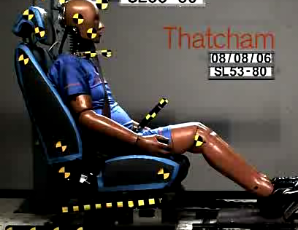
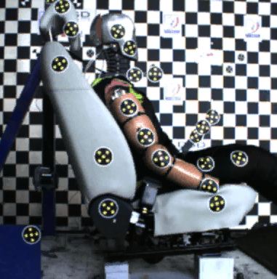
BioRID 50F – BioRID II

Slide 14
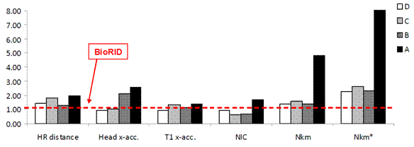
BioRID 50F - BioRID II
Four production seats

Slide 15
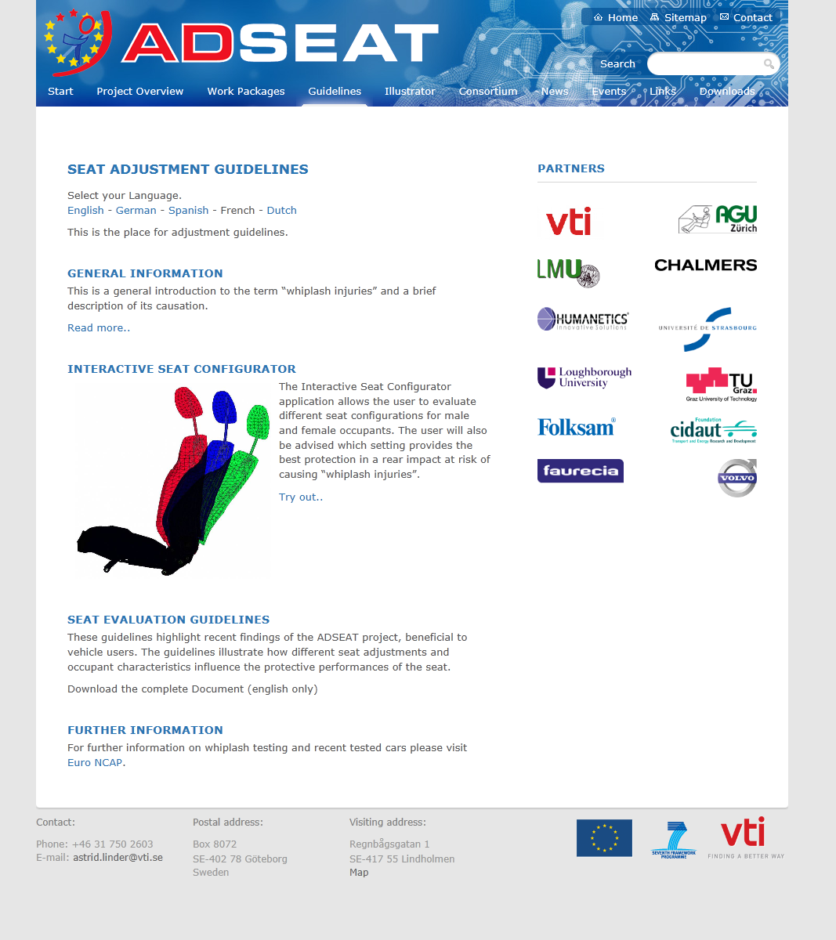
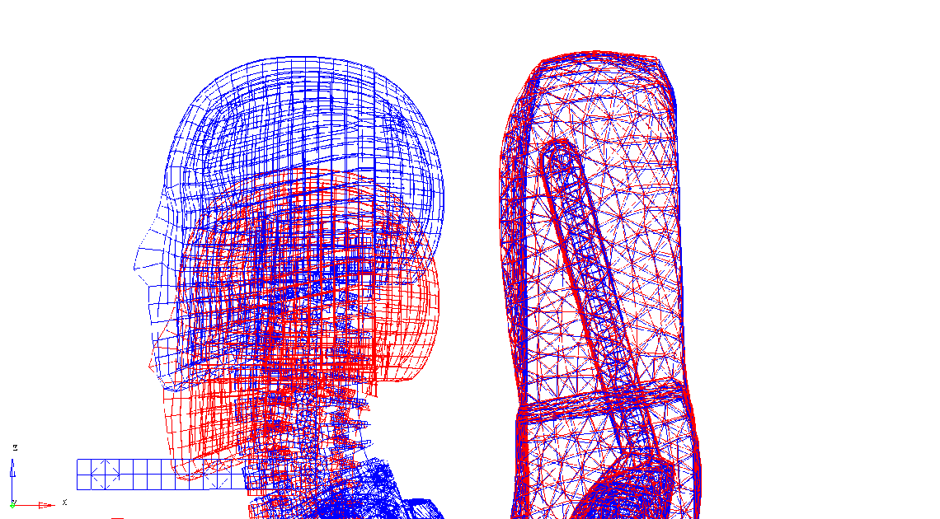
Illustrator and Seat Evaluation
www.adseat.eu

Slide 16
Discussion
Large differences in safety performances between different anti-whiplash systems.
Occupant and seating posture diversity should be addressed in the area of crash testing.
Improved evaluation of safety performances is needed in order to identify and promote best designed systems in testing programs, such as NCAP.

Slide 17
Material
For studying occupants with symptoms > 1month
  52 225 occupants reporting whiplash symptoms
  10 115 resulted in symptoms > 1 month (20%)
For studying occupants with pmi
  50 343 occupants reporting whiplash symptoms
  5 368 resulted in pmi (10%)
Kullgren et al. (2013) Development of Whiplash Associated Disorders for Male and Female Car Occupants in Cars Launched Since the 80s in Different Impact Directions, IRCOBI Conference

Slide 18
Whiplash concepts, risk for pmi
-13%
52%
47%
70%
Kullgren et al. (2013) Development of Whiplash Associated Disorders for Male and Female Car Occupants in Cars Launched Since the 80s in Different Impact Directions, IRCOBI Conference

Slide 19
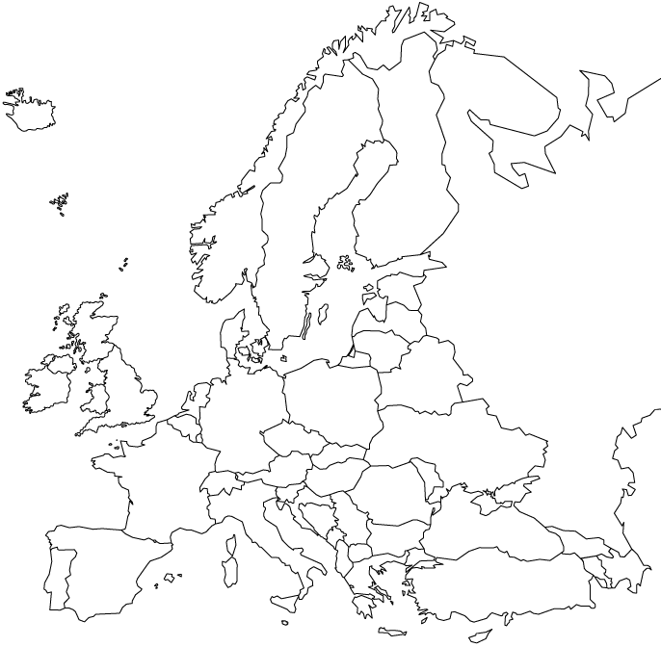




Thank you for your attention!

