Slide 1
Gender in the Culture of Technological Sciences
Brigitte Ratzer
Center for Promotion of Women and Gender Studies

Slide 2
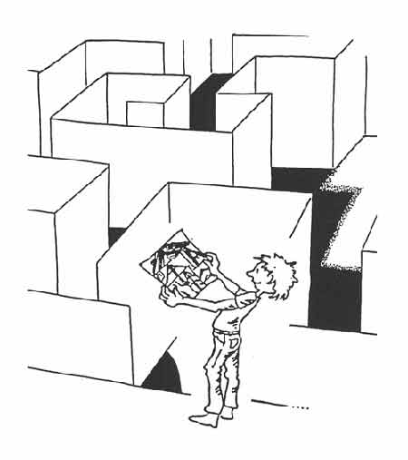
Agenda
Fix the number of Women
1. What about women in Technological Sciences?
2. Why are the problems in recruiting women so persistent?
3. What ought to be done?
Fix the Institutions
4. Working cultures in Technological Sciences – what makes the difference?
5. What measures seem appropriate?
Fix the Knowledge
6. What is Technology?
7. Curricula – what must be done?
8. Gendered Innovations?
9. Some more Questions to be asked...

Slide 3
Fix the number of Women

Slide 4
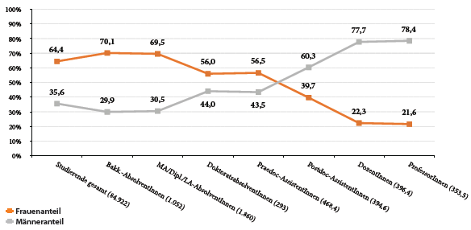
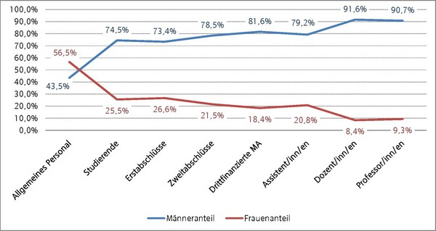
Leaky Pipeline: an other shape…
University of Vienna, 2011
Vienna University of Technology, 2010

Slide 5
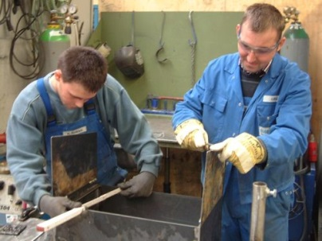
… caused by fundamental narratives ….
“Different childhood exposure to technology, the prevalence of different role models, different forms of schooling, and the extreme gender segregation of the job market…”
Judy Wajcman: Feminist theories of technology.
Cambridge Journal of Economics 2009
Notes:
Different childhood exposure to technology, the prevalence of different role models, different forms of schooling, and the extreme gender segregation of the job market all lead to what Cockburn (1983, p. 203) describes as ‘the construction of men as strong, manually able and technologically endowed, and women as physically and technically incompetent’. Entering technical domains therefore requires women to sacriﬁce major aspects of their feminine identity.

Slide 6
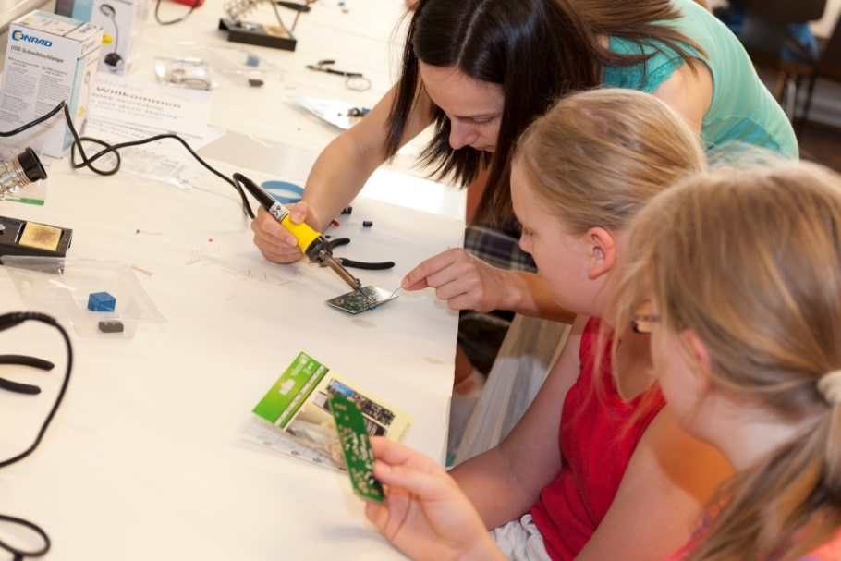
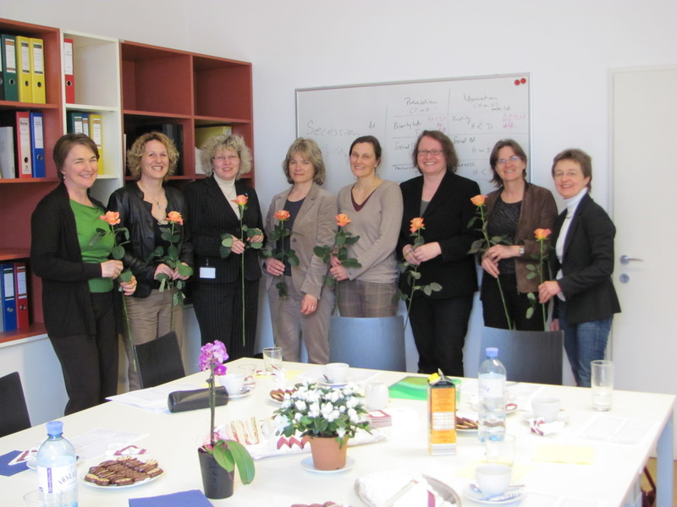
…means additional tasks.
Girls Days
Role Modells
Hands-on Workshops
Mentoring
Coaching
Notes:
Give them the experience
This is interesting and relevant also for me and my life
I can do it
There are others
Reconciliation with my family-planing is possible
BUT: only selected contacts with technology is not enough, because the message „Technology is about boys and their toys“ is universal and widespread!

Slide 7
The ”Hot Potatoe” Circle
Kindergarten
Parents
Media
School
University
Society

Slide 8
Fix the Institutions

Slide 9
Working Cultures in Technological Sciences
Technological Sciences are different from other academic fields. Discrimination, bullying, long working hours & old boys networks are the same, but in addition:
Technicians are often emotionally reduced.
Token-effects occur from the beginning.
Women are not there, because they don´t want to be there!

Slide 10
Working Cultures in Technological Sciences
“… we need to address the broader questions of whether and in what way technoscience and its institutions can be reshaped to accommodate women. Such critiques emphasize that, in addition to gender structures and stereotyping, engrained cultures of masculinity are still ubiquitous within these industries, causing many young women to reject careers and older women to leave the field.”
Judy Wajcman: Feminist theories of technology.
Cambridge Journal of Economics 2009
Notes:
This is not to say that all women reject ‘geek culture’, nor that computer science is universally coded as masculine. Sexual ideologies are remarkably diverse and ﬂuid, and for some men technical expertise may be as much about their lack of power as the realisation of it. However, in contemporary Western society, the hegemonic form of masculinity is still strongly associated with technical prowess and power (Wajcman, 1991). Different childhood exposure to technology, the prevalence of different role models, different forms of schooling, and the extreme gender segregation of the job market all lead to what Cockburn (1983, p. 203) describes as ‘the construction of men as strong, manually able and technologically endowed, and women as physically and technically incompetent’. Entering technical domains therefore requires women to sacriﬁce major aspects of their feminine identity.
us to understand how our relationship to technology is integral to the constitution of subjectivity for both sexes (Haraway, 1997). To continue with the example of engineering for a moment, here we see a classic case of an archetypal masculine culture, where mastery over technology is a source of both pleasure and power for the predominantly male profession (Faulkner and Lohan, 2004; Hacker, 1989). Such images resonate with the world of computer hackers at MIT described by Sherry Turkle (1984, p. 216): ‘though hackers would deny that theirs is a macho culture, the preoccupation with winning and of subjecting oneself to increasingly violent tests make their world peculiarly male in spirit, peculiarly unfriendly to women’.

Slide 11
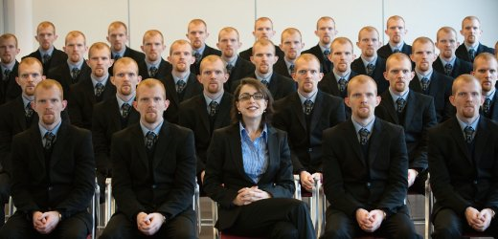
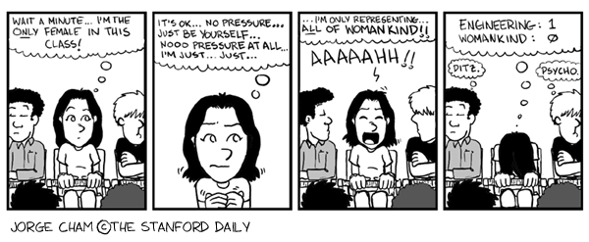
What makes the difference?

Slide 12
Token Effects

Slide 13
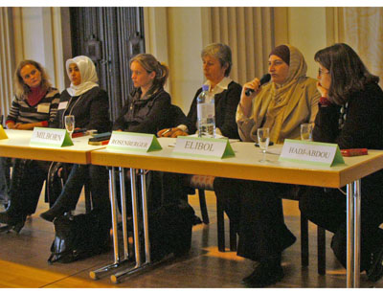
Intersectionality

Slide 14
What can be done?
gender quota
see discourse on Gender and Excellence (in what way are selection procedures biased?)
neutralize application procedures (anonymous applications)
family friendly policies (part-time, teleworking, kindergarten, etc.)
improve working conditions & climate

Slide 15
Fix the Knowledge

Slide 16
What is Technology?
Technologies influence how people are going to work, communicate, travel, consume, and so forth over a very long time.
Structures for technologies are chosen - consciously or unconsciously, deliberately or inadvertently.
Langdon Winner: Do artefacts have politics?
London: Open University Press, 1985
A diverse workforce is required in order to produce artefacts that include diverse ways of living.
Notes:
Environment, social impact, economical impact, history, responsibility

Slide 17
Curricula
Curricula of technical degree programms suggest what is “in” and “outside” the technical focus.
What about the environment, social impact, economical impact, health risks, history, responsibility of engineers?
Significantly more women enrole in interdisciplinary degree programms.
(WOMENG synthesis report 2005)

Slide 18
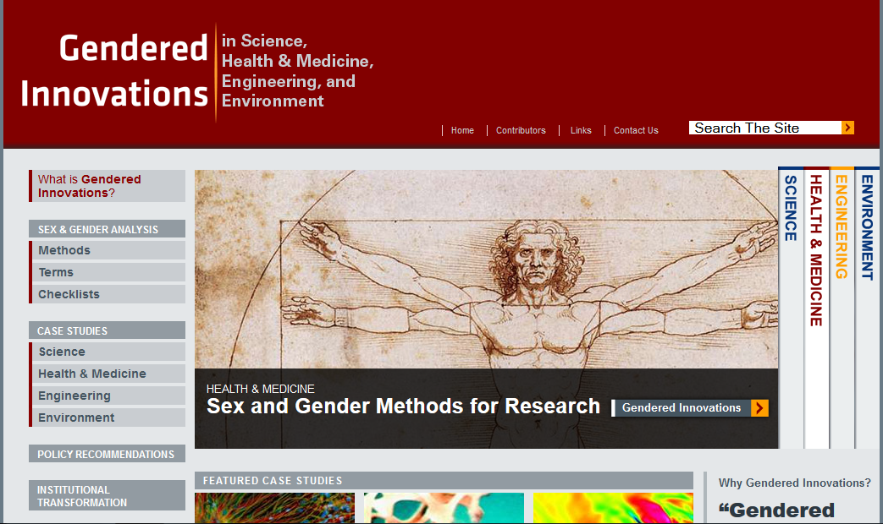
Gendered Innovations

Slide 19
…and what could be obstacles
research and innovation funding in Europe is directly linked to economic interests (maximum profit) and the international competitiveness of the European economy.
research funding in many countries is to a large extend financed by the military sector.
the current research community is predominantly white, male and middle class, reflecting their interests and topics.

Slide 20
What questions should we ask?
Does the product succeed in business ?
Does the product meet ecological standards?
User-orientation: for whom is this research benefical – who is/remains excluded?
Problem-orientation: In which world do we live? – What do we need?
Design-orientation: In which world do we want to live? – What do we need therefore?

Slide 21
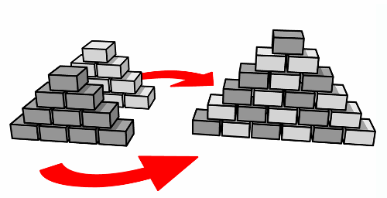
The task ...

Slide 22
... some current efforts...
Ahead!

Slide 23
Thank you for your attention!

Slide 24
Engineering Cultures in Higher Education
Characterized by Wendy Faulkner
“ …some aspects of the association between masculinity and technology—an association that operates largely at the level of the image technology holds for outsiders, and that I argue contributes to the continued male dominance of many technological occupations.
This reveals a key feature of the people-technology dichotomy, namely that it is assumed to be mutually exclusive. Yet, most women routinely interact with people and technologies; some even develop strong emotional attachments to artifacts they use a lot, be it a washing machine or a pager (Berg, 1997, chs. 4 and 5).

Slide 25
THE TECHNOLOGY QUESTION IN FEMINISM: A VIEW FROM FEMINIST TECHNOLOGY STUDIES
Of course, many of the ways of thinking and doing, which we stereotypically deem feminine, are useful if not essential in technical work: linguistic abilities in computer programming, for instance. And plenty of women now do jobs that are extremely technical, just as plenty of men are technically incompetent. In short, there are huge mismatches between the image and practice of technology with respect to gender. This crucial point is often missed. Yet I believe it obliges us to look more closely at the relationship between the continued male dominance of engineering and masculine images of technology, and at how these images are sustained.
Notes:
The hard–soft dichotomy also extend to styles of thought in technology (Edwards, 1996, pp. 167–72), because the association of engineering with scientific methods brings with it long-standing gender dualisms: on the masculine side of those dualisms we have an objectivist rationality associated with emotional detachment and with abstract theoretical (especially mathematical) and reductionist approaches to problem solving. On the feminine side we have a more subjective rationality associated with emotional connectedness and with concrete, empirical, and holistic approaches to problem solving.

